Slide 1
Our Application Under Test

Slide 2
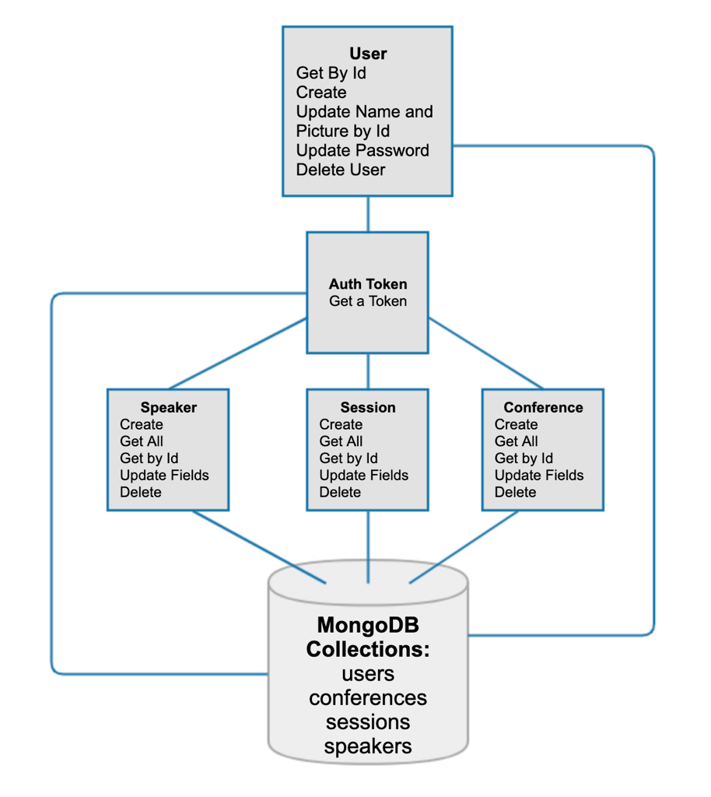
User creates an
auth token
Create a user or admin with
Master Token
Use that auth token
to invoke other endpoints,
some are admin

Slide 3
The fun part…
MongoDB
Node and NPM
Robo3T
Postman
An editor
The app

Slide 4
Up and running
Pull the latest from the repo
Open in your editor
Terminal > Root of App > Type “npm install”
Terminal > Root of App > Type “npm run dev”

Slide 5
Postman Collection
Create a User
Create an admin user
Create an Auth Token for both
Postman Variables

Slide 6
Documentation
Autogenerated docs
An important operability win!
Terminal > Root of App > Type “npm run docs”
A project with actual docs!

Slide 7
Testing feedback?
Anyone do any testing?
Managed to operate the app?
Bugs found?
Insights to share?
Burning questions?
Terrified?

Slide 8
For familiarity
Tests in Speakers Endpoint for:
Get
Put
Test in Sessions Endpoint for:
Delete

Slide 9
Ready?

